Slide 1
Decisions Rules
Heuristics
Very simple decision short-cuts.
Usually reasonable decisions, bad in specific situations.
Non-compensatory
Simpler decision models.
Cannot compensate for low standing on one attribute by being better on another.
Compensatory
Cost/Benefit analysis.
Excelling at one dimension can make up for poor dimensions .
Lower Effort, Lower Accuracy
Higher Effort, Higher Accuracy
Notes:
Most Simple: ~~~ Heuristics = rules of thumb, very simple – only used under low effort.
Also have the lowest accuracy – usually pretty good rules, but can sometimes lead you astray.
Middle Option: ~~~ Non-Compensatory --- relatively high effort and improved accuracy
In NonCompensatory models doing well on one thing cannot make up for doing badly on another. Negative info leads to elimination of option from further consideration.
Most Difficult ~~~ Compensatory ~~~ highest accuracy
Compensatory models – doing well on one attribute can compensate for doing poorly on another. e.g., in compensatory model, a very expensive product can make up for how expensive it is based on how good it is on other features – performance – but in a noncompensatory model, a product can be dropped simply for exceeding a certain price threshold).

Slide 2
Heuristics
Mental rules-of-thumb that lead to a speedy decision (i.e., mental shortcuts).
Examples:
  Product signal (clean and shiny = good car)
  Market beliefs (more expensive = better)
  Country of origin (is this made in America?)
  Familiar brand names (new = bad)
  Inertia (but this is how I’ve always done it)
  Brand loyalty (RC Cola is better than Coke AND Pepsi!)
Notes:
Product signal: Observable product attributes that communicate underlying qualities
Clean and shiny car = good mechanical condition
Market belief: Consumer assumptions about companies, products, and stores that become shortcuts for decisions
Price-quality relationship: We tend to get what we pay for
Other common marketing beliefs
All brands are basically the same
Larger stores offer better prices than smaller stores
Items tied to “giveaways” are not a good value
Country of Origin: We rate our own country’s products more favorably than do people who live elsewhere
Industrialized countries make better products than developing countries
Attachment to own versus other cultures
Nationalists
Internationalists
Disengaged
We strongly associate certain items with specific countries (stereotyping)
Country-of-origin effects stimulate consumer interest in the product
Expertise with product minimizes country-of-origin effects
Ethnocentrism (“buy Canadian”)
‘The Rant’ – Molson Canadian
Olympic Games clothing worn across the country
Familiar Brand Names: Our tendency to prefer a number one brand to the competition
Brands that dominate the market are sometimes 50% more profitable than their nearest competitors
Consumer Inertia: Tendency to buy a brand out of habit merely because it requires less effort
Brand loyalty
Discussion Opportunity—Have students write down three brands they buy repeatedly. Which ones are due to inertia vs. brand loyalty?

Slide 3
Non-Heuristic Strategies: Evaluative Criteria
Evaluative criteria: dimensions used to judge merits of competing options – what is important to the consumer.
Determinant attributes: features we use to differentiate among our choices.
Criteria on which products differ carry more weight.
Marketers educate consumers about (or even invent) determinant attributes.
Notes:
Evaluative criteria: What’s important to the consumer – what makes the decision.
Help evaluating alternative comes in the form of cybermediaries such as bizrate.com which helps to filter and organize info (such as comparing alternatives).
Also, many websites have electronic recommendation agents that filter through the clutter for you by suggesting products you may enjoy based on you search and purchase history – e.g. Amazon.

Slide 4
Non-Compensatory
Non-compensatory: a product with a low standing on one attribute can’t compensate for this flaw by doing better on another attribute.
Different ways to evaluate products based on attributes:
Conjunctive Rule
Disjunctive Rule
Lexicographic Rule
Elimination-by-Aspects Rule
Notes:
4 types of non-compensatory decision rules—remember non-compensatory because performing well on one attribute does not allow you to compensate for poor performance on another. Based on CUTOFFS!
Conjunctive ~
Set minimum cutoffs on multiple dimensions
Start with all items and reject bad options
Choose first brand that meets all cutoffs
Disjunctive ~
Set acceptable standards for dimensions --- these are often higher than min cutoffs and then evaluate the options as with the conjunctive rule.
Lexicographic ~
we rank the attributes in terms of importance and then go through them in order until we find an option that wins on one of the attributes. That’s our choice. If there’s a tie, we keep going down the list of attributes until 1 wins
Elimination by Aspects ~
Rank attributes by importance
Set minimum level on most important attribute and then 2nd, and then 3rd, and then 4th….
Eliminate brands that don’t meet cutoff on most important dimension
Eliminate brands that don’t meet cutoff on 2nd most important dimension
Continue until 1 brand remains
***Text book does a great job overviewing the details of these rules!

Slide 5
Compensatory
Compensatory decision rules: give a product a chance to make up for its shortcomings
Types of compensatory decision rules:
Simple additive rule: the consumer merely chooses the alternative that has the largest number of positive attributes (pro/con list!)
Weighted additive rule: the consumer also takes into account the relative importance of positively rated attributes, essentially multiplying brand ratings by importance weights
    E.g. Overall Attitude Score (Fishbein Model) = the same of a consumer’s rating of each attribute for brand multiplied by the importance rating for that attribute
Notes:
Two types of compensatory decision rules—
Simple additive (basic pros/cons list)—even if some attributes are not important; just looking to see which alternative has the most positive attributes
Weighted additive—relative importance, weighted attributes (similar to multi-attribute attitude models)

Slide 6

Outcomes
Satisfaction?
Post-purchase dissonance?
Role in consumers life?
Notes:
What are the outcomes of this decision process? How does the model we discussed think about this?
Discussion: Really the decision-making model leaves us with the idea that once we make a decision and purchase, we come back around to new problem recognitions which lead us through a new version of the process. But in reality we think about a lot of other things, like: customer satisfaction with a decision (immediately and over time); we think about buyer’s remorse (ask students to define that); and we think about how products and services fit into a consumer’s life over the longer run.

Slide 7
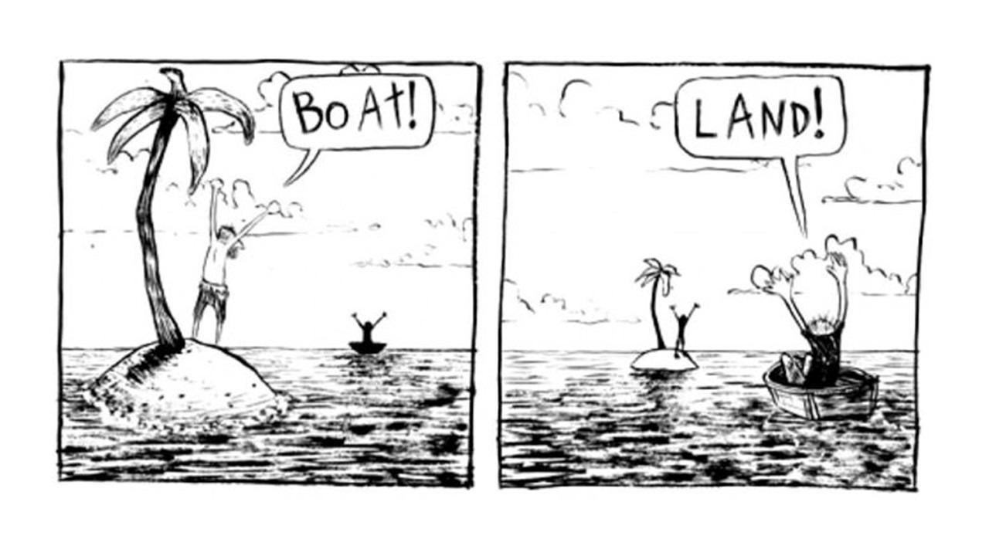
What’s Next?
Chapter 2: Perception
Notes:
For next class, please read through the chapter on perception! Email me if you have any questions about anything from today’s class, and have a great weekend!

